Slide 1
COLLOIDS

Slide 2
Colloids are heterogeneous solution formed by dispersion of fine particles (dispersed phase) dispersed into another substance(dispersed medium)
The diameter of the dispersed phase is between 1 and 100 nm.
Colloids possess high surface area of 6 cm2

Slide 3
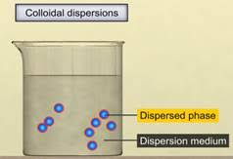

Slide 7
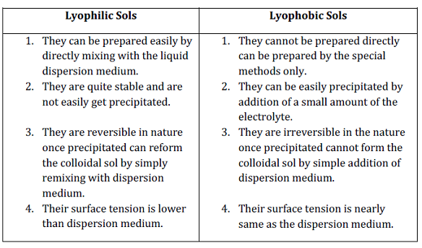

Slide 10
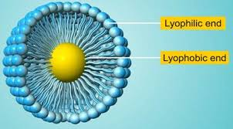
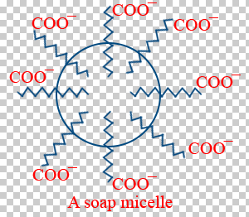

Slide 12
PREPARATION OF COLLOIDS

Slide 14
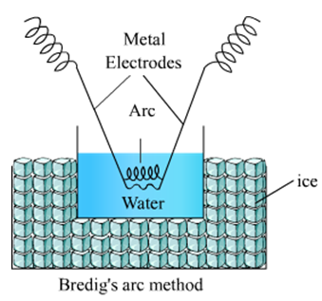

Slide 19
